Slide 1
Learning to See “Waste”
I’m not in the Muda to waste my time!
Notes:
Good afternoon. My name is Jason Knight, Sr Scrum Master with the MortgageNow product development team. Today, I’d like to teach you to see waste as defined by Lean thinking. Put another way,
[animation]
I’m not in the Muda to waste time. That joke will be funny later I hope.

Slide 2
What causes you the most pain at work?
Dad Jokes
Interruptions
Reaching the right people and waiting on responses
Misinterpreting written written communication
Meeting without adequate outcome
Notes:
Let’s start with some audience participation. Please unmute and tell me what about your day to day work causes you the most pain or irritation.
[exercise]
Let’s come back to these things a bit later once we’ve better understood the 7 wastes of Lean.

Slide 3
What is Value According to Lean?
Value is created when:
The customer is willing to pay for the product or service
The work transforms the product or service
The work is done right the first time
Notes:
To understand waste, we must first understand value in Lean thinking. In lean, value is created when:
[animation][read bullet]
[animation][read bullet]
[animation][read bullet]

Slide 4

Notes:
If I were building a car, this would be value-adding since the customer wants to by the car.

Slide 5
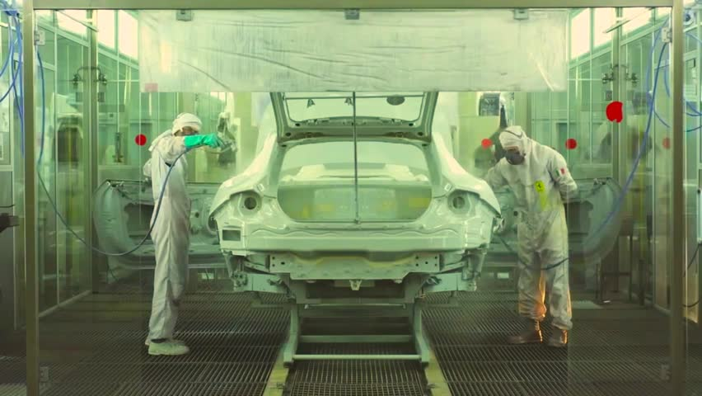
Notes:
If I am painting the car body, I’m transforming the product into the product the customer wants to buy. This is therefore a value-adding activity

Slide 6

Notes:
If all of the activites needed to produce and transform the car were done without defect, then every activity was valuable. Any activities that produced defects would not be valuable since they’d need to be reworked.

Slide 7
How much work is typically “valuable”?
Notes:
https://petersco.net/what-is-lean/
Now consider all the work necessary to operate the Car assembly plant. There’s accounting, HR functions, and management needed. All of that would not be considered “value-adding” since the customers only wants to pay for the car.
Go off mute for a minute and try go guess ow much work is “value-adding” in the average organization? Any guesses?
[animation]
I’ve been told by lean consultants who consult widely that the percentage is close to 5% with 95% being considered waste. If you’ve never heard this before, it can be a jarring concept. Even Toyota which has been working at removing waste for decades still has something like 50% of their activities that would qualify as waste.

Slide 8
How much work is typically “valuable”?
Notes:
https://petersco.net/what-is-lean/
Not all waste is created equally. Some work that is not “value-adding” still directly supports value-adding work. Think of the HR representative who issues paychecks. This surely supports the value-adding work but is not itself value-adding.
That said, much activity is pure waste and does not even support value-adding work. It is this pure waste I’m going to focus on today.

Slide 9
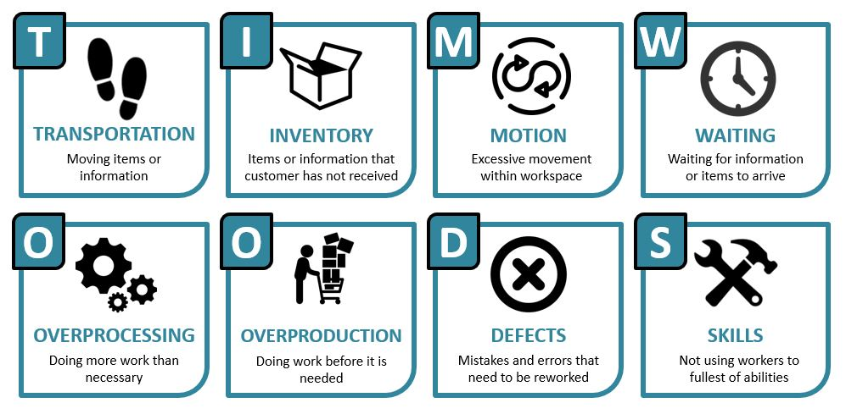
The 7 Wastes (Muda)
Handoffs
Partially Done Work
Context Switching
Still Waiting ☺
Extra Processes and Re-learning
Delivering Extra or Unneeded Features
Still Defects ☺
Notes:
The Japanese word muda describes uselessness in processes and things. Toyota have described 7 different types of waste that occur when we work. These wastes have also been reinterpreted in the realm of knowledge work like software development. You’ll first see the classic manufacturing definition of the waste, then I’ll describe how that waste can occur in Software development. Imagine a new feature being developed for your favorite software application.
Transportation waste can be those handoffs that occur as incomplete work is handed from ui designer to programmer to tester.
Inventory would be your team’s work in progress during a Sprint.
Motion could be all those context switches you go through on a daily basis. Did you know each one probably costs you about 15 - 20 minutes of lost productivity?
Waiting is still just waiting :D
Overprocessing looks like overly complicated processes or re-learning.
Overproduction is still quite impactful. Think of a feature you work hard to deliver that the users don’t use. All that work, including the waste to produce it does not deliver the promised value of use.
Defects are still defects.

Slide 10
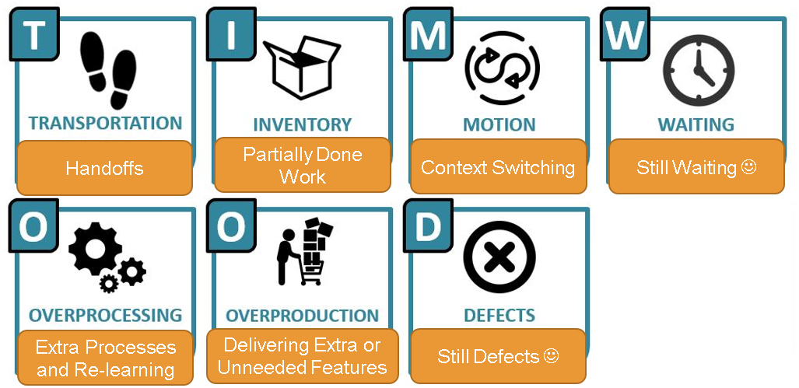
S
S
S
S
S
S
S
S
Dad Jokes
O
O
O
O
O
O
O
O
O
O
O
O
O
D
D
D
D
D
D
D
M
D
M
M
M
M
W
W
W
W
T
W
T
T
T
T
T
I
I
I
I
I
I
I
Interruptions
M
O
Reaching the right people and waiting on responses
Misinterpreting written written communication
Meeting without adequate outcome
W
T
M
W
O
Notes:
[Copy from previous slide and tag with wastes]

Slide 11

In the Muda to ask a few questions?

Slide 12

Final Thoughts
Notes:
Alright, let’s wrap things up with some final thoughts.

Slide 13
Final Thoughts
Lean concept of value can be very challenging
Lean “Waste” (Muda) is never a person
Problems are gold nuggets
Wastes help us see problems around us. This is good!
Notes:
The lean concept of value and waste can be very challenging. No one wants to think of their work as waste; however, focusing on the customer and what they would pay for is powerfully transformative.
I’ve been thought that people should never be thought of as “waste.” Only processes and structures should be considered.
Waste is a problem and each problem is a little gold nugget. Solving the most important ones can recover massive amounts of energy, cost, and bring enormous satisfaction at work.
Learning to see waste helps us see the problems around us and use specific concepts to understand and solve for them.

Slide 14
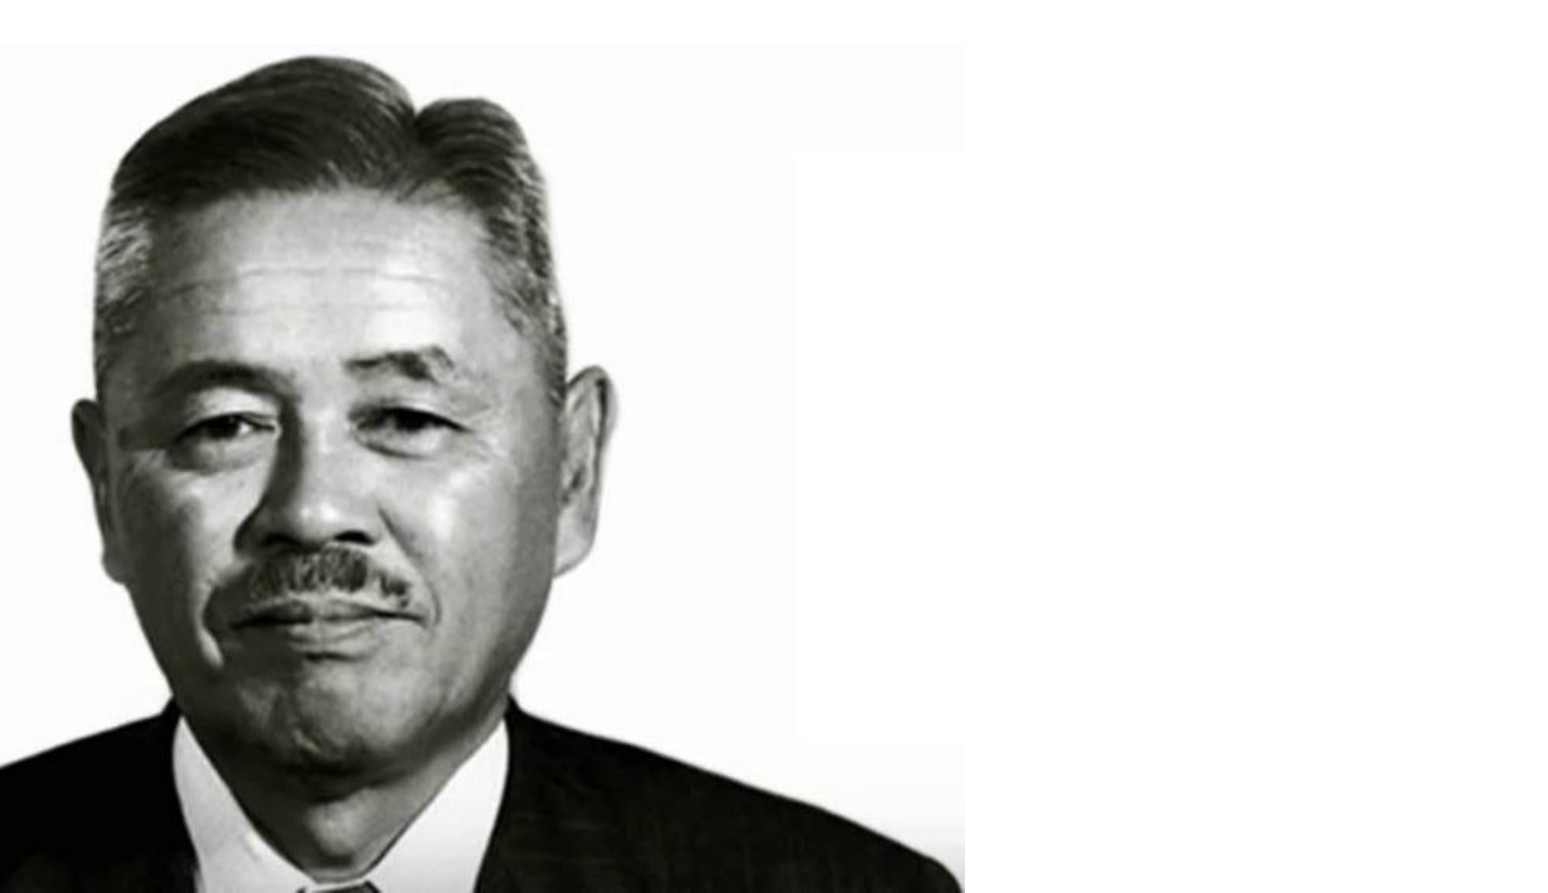
Taichi Ohno
Father of Toyota Production System
Work inspired US Lean manufacturing and agile software development
Wrote Toyota Production System
Instrumental in developing 7 Wastes
Notes:
And now a few final thoughts from special guest, Taichi Ohno.

Slide 15
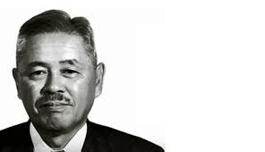
First say, “I can do it.” And try before everything.

Slide 16
Re-improve what was improved for further improvement.

Slide 17
Waste is hidden. Do not hide it. Make problems visible.

Slide 18
Having no problems is the biggest problem of all.

Slide 19
Valueless motions are equal to shortening one’s life.
Notes:
Wasteful actions to Ohno were like wasting the precious and unrecoverable time in a person’s life. His hope and mine is that we can learn to see the waste around us and dedicate ourselves to finding and removing as much of it as possible and in so doing, respect the precious lives of our friends and co-workers.

Slide 20


Slide 21
The 7 Wastes (Muda)
Notes:
The Japanese word muda describes uselessness in processes and things. Toyota have described 7 different types of waste that occur when we work. I’ll highlight just a few here. Inventory is items or information that haven’t made their way to the customer. Managing inventory is waste because the customer doesn’t want to pay for it. Think of a stack of Jeeps that need their paint jobs applied. They represent inventory and the cost associated with managing it.
Defects are dire waste. No only do the customers not want to pay for defective work, but the time spent fixing the defects is time that could have been being used on value-adding activities.
Last, overproduction is probably the worst. Imagine a pile of finished Jeeps that won’t be purchases for months, if at all. Imagine all the cost that went into producing those Jeeps that don’t get sold or won’t produce revenue until they are?

Slide 22
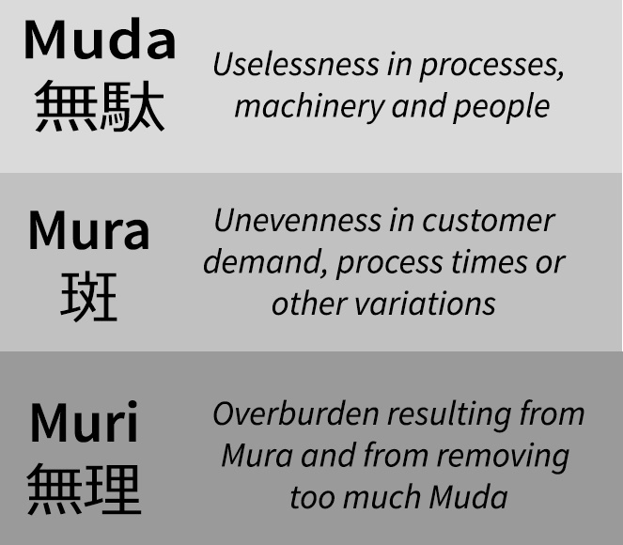
Waste, Unevenness and Overburden

Slide 23
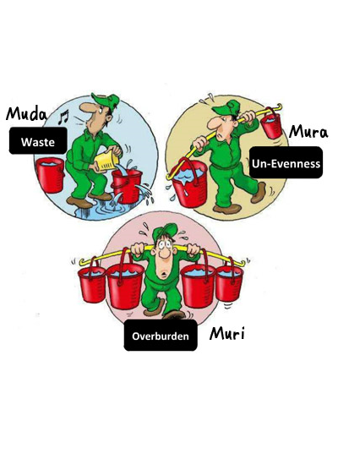
Waste, Unevenness and Overburden

